Slide 1
PRINCIPLES OF PLOS

Slide 2
Outcome Pyramid
How does it all fit together?

Slide 3
What are learning outcomes?
Goals we set for student learning
Institutional Learning Outcomes
Program Learning Outcomes
Student Learning Outcomes
Outcomes vs. Objectives
At COD

Slide 4
Program Learning Outcomes
What are they?
Knowledge, skills, and attitudes that a student should have at the completion of a program.
What is considered a “program”
A course or series of courses that lead to a certificate or degree.
Like SLO’s, PLO’s should be observable and measurable.
Rule of Thumb for the number of PLOs needed
Programs leading to a certificate should have 2 PLO’s
Programs leading to a degree should have 4 PLO’s

Slide 5
Where do I find my PLOs?

Slide 6
Why PLOs?
Program Planning Program learning goals help faculty plan the curriculum, assess coherence and sequencing, and evaluate the learning of majors. In addition, they signal the program’s disciplinary identity and provide a common language that students, faculty, and staff share.
Curricular Assessment and Change The assessment of PLOs provides data that takes “felt” issues in a program and illuminates their realities which provides opportunity for tangible change that benefits students.
Institutional Cohesion They can show how each program within the institution relate to each other and fulfill specific student needs.
Improved Academic Advising Learning goals for each course are an important first step toward clearly communicating expectations to students and assisting them in matching courses and majors with student interests and capabilities.
Evidence for Accreditation They say we gotta.

Slide 7
Writing CLEAR PLOs
Cumulative: PLO’s should encompass all of the skills and abilities a student would develop through the entirety of the program.
Linked: PLO’s should be directly tied to course SLO’s that lead to the program award and Institutional Learning Outcomes.
Exclusive: Be sure your PLO’s describe your program specifically.
Assessable: Use Bloom’s Taxonomy to ensure that PLO’s are measurable.
Reflect Students: PLO’s should communicate what students should be able to do once completing the course.

Slide 8
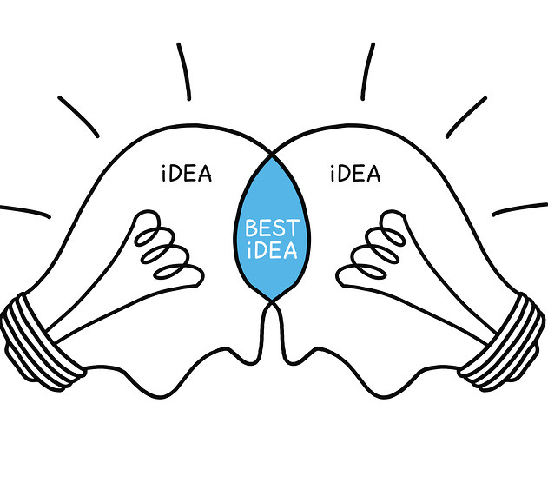
Methods of Development
Begin with Departmental Collaboration
Discuss:
Foundational courses
Capstone course or experience
Areas of concentration in the program
Required/elective courses
A curricular map

Slide 9
Questions to Guide Writing PLOs
What should my students be able to do when they’ve finished my program?
How do my program’s courses lead to a “finished” product?
How could I assess this PLO?

Slide 10
Refining PLOs
What are the key concepts, change points, capstone courses in your program?
What are the three to five most important outcomes on which you would concentrate?
Are your outcomes statements consistent with your statement of purpose and mission?
Are your outcomes statements specific enough to relate only to your program but not so specific that you need a bunch of them to describe your program?
Are your outcomes statements reasonable enough given the ability of your students?

Slide 11
PLO Assessments
PLOs can be assessed in many ways
Direct assessment
Key Assessments, Portfolios, and Capstones.
Indirect assessment
Review of program data
Alumni surveys

Slide 12
Great example of PLO’s Compare the following PLO’s with the guidelines provided in “A Practical Guide to PLO’s”
Advanced First Aid and Safety, CPR/AED
(Certificate)
Assess victims of injury and medical emergencies and apply an emergency action plan.
Demonstrate advanced knowledge, skills, and techniques in Cardiopulmonary Resuscitation and Automatic External Defibrillator
# of PLO’s appropriate for Certificate program.
Outcomes are:
Cumulative
Linked
Exclusive
Assessable
Reflect Student abilities
Notes:
This is a great example! The right number of PLOs are present for a certificate program (2-3 recommended by ACCJC) and the outcomes are CLEAR.

Slide 13
Great example of PLO’s Compare the following PLO’s with the guidelines provided in “A Practical Guide to PLO’s”
Musical Theater
(Certificate)
Students will effectively interpret musical theatre scripts and songs.
Students will integrate interdisciplinary performance skills required for success in the musical theatre field.
# of PLO’s appropriate for Certificate program.
Outcomes are:
Cumulative
Linked
Exclusive
Assessable
Reflect Student ability
Notes:
Another great example. If you didn’t see “musical theater” you’d still know that these PLOs belong to that area because they are so specific! The number of PLOs recommended for a certificate program is 2-3.

Slide 14
Example of PLOs not following best practice guidelines Compare the following PLO’s with the guidelines provided in “A Practical Guide to PLO’s”
Recommended # of PLO’s for degrees 3-4
Fire Technology
(AS Degree for employment Preparation)
Outcomes are:
Cumulative
Not linked to the course
Not exclusive to the program
Assessable
Reflect student abilities
General CTE outcomes
Apply critical thinking skills to research, evaluate, analyze, and synthesize information.
Display the aptitude and knowledge necessary to qualify for certification exams in their field.
Notes:
The recommended number of PLOs for a degree is 3-4.
Although only 2 outcomes were selected out of several generic CTE outcomes, they aren’t specific to the program.
Unable to determine that these belong to Fire Technology because they are not linked to the course
These are general CTE outcomes
If this is a degree for employment, maybe an outcome related to that preparation would be an idea.

Slide 15
Example of PLO not following best practice guidelines Compare the following PLO’s with the guidelines provided in “A Practical Guide to PLO’s”
Integers
(Certificate)
Help students to develop foundational numeracy skills in integers
Prepare students with a proper knowledge to be successful in the subsequent math courses.
# of PLO’s appropriate for certificate
Outcomes are:
Cumulative
Linked
Exclusive
Not Assessable
Reflects a teacher focus, not student ability
Notes:
The number of PLOs is appropriate for a certificate program (best practice= 2-3)
Both PLOs are teacher centered rather than student centered. The outcome is what the instructor will do.
The second PLO is not assessable and may be unrealistic. Can this one course prepare a student for ALL Subsequent math courses?

Slide 16
Reach us at…
SLO@collegeofthedesert.edu

