Slide 1
Dating Violence & Date Rape
College of the Desert Public Safety Department & Emergency Preparedness
2021

Slide 2
Dating Violence
Violence committed by a person who is or has been in a social relationship of a romantic or intimate nature with the victim
and where the existence of such a relationship shall be determined based on a consideration of the following factors:
    -The length of the relationship.
    -The type of relationship.
    -The frequency of interaction between the persons involved in the
    relationship.

Slide 3
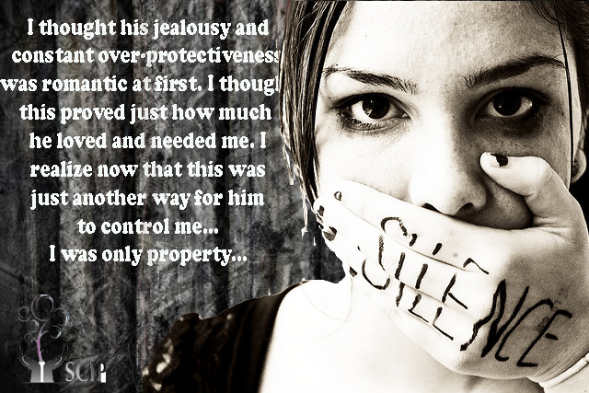
Statistics
Girls and young women between the ages of 16 and 24 experience the highest rate of intimate partner violence – almost triple the national average.
Approximately 70% of college students say they have been sexually coerced.
50% of youth who have been victims of both dating violence and rape attempt suicide – an extremely high number compared to the 12.5% of non-abused girls and 5.4% of non-abused boys.

Slide 4
LGBTQ+ Abusive Relationships
Everybody deserves a healthy and safe relationship. Many think same-sex couples cannot be in abusive relationships because they are the same gender – this is not true.
Lesbian, gay, bisexual, transgender and queer/questioning (LGBTQ+) youth experience dating abuse at the same rates and in similar ways as heterosexual couples do. In fact, one in three young people (gay, straight, and everyone) experience some form of dating abuse.

Slide 5
Obstacles for LGBTQ+ to Get Help
Many LGBTQ+ teens and 20-somethings believe that no one will help them because they are transgender or in a same-sex relationship.
Shame or Embarrassment. May be struggling with their own internalized homophobia or shame about sexual orientation or gender-identity. An abusive partner may attempt to use this shame to exert power and control.
Fear of not Being Believed or Taken Seriously. May worry if abuse is reported, they will encounter common stereotypes like violence between LGBTQ+ partners is always mutual, abuse doesn’t occur in lesbian relationships, only the physically bigger partner can be abusive or LGBTQ+ relationships are inherently unhealthy. A partner may exploit fear, trying to convince you that no one will take an LGBTQ+ victim seriously.

Slide 6

Obstacles for LGBTQ+ to Get Help
Fear of Retaliation, Harassment, Rejection or Bullying. If someone is not “out” to everyone, the abusive dating partner may threaten to tell the secret to people who will make life more difficult once they know. The victims may fear that seeking help will make them a target of public ridicule, retaliation, harassment or bullying. The abusive partner may exploit these fears to isolate the victim and keep the relationship going.
This Photo by Unknown Author is licensed under CC BY

Slide 7
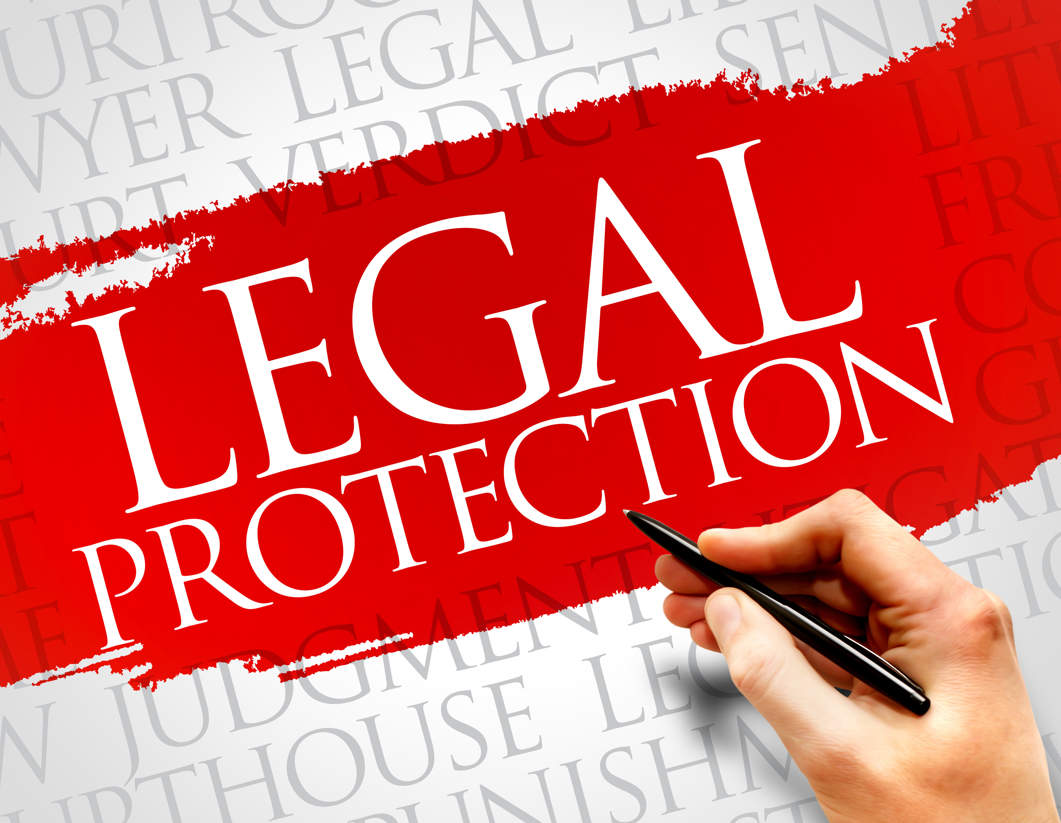
Obstacles for LGBTQ+ to Get Help
Less Legal Protection. Victims may be unaware that they have legal options for protection. Options that include obtaining a restraining or protective order. Although laws vary from state to state, and some specifically restrict restraining orders to heterosexual couples and not homosexual couples, most states have gender-neutral laws that do not discriminate on the basis of sexual orientation.
Note: The State of California is a gender-neutral state regarding restraining orders.

Slide 8
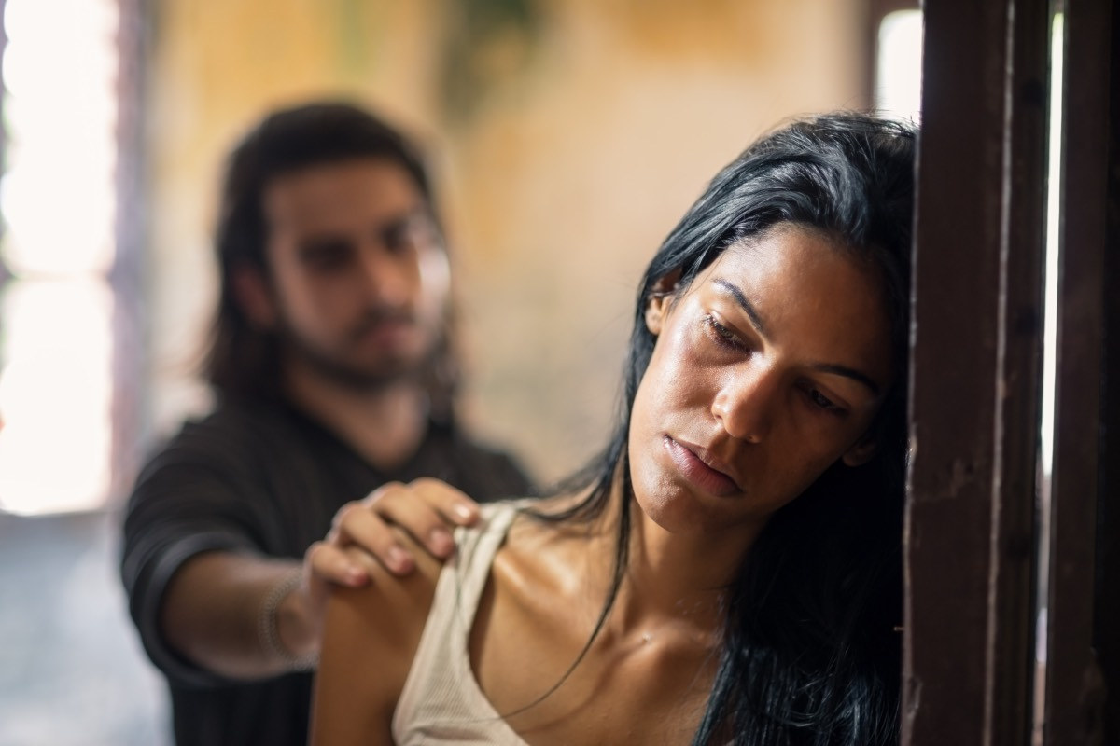
Warning Signs of Dating Abuse
The warning signs of dating abuse are similar to those of domestic abuse regardless of . The warning signs include, but are not limited to, the following:
  Checking your cell phone or email without permission
  Constantly putting you down
  Extreme jealousy or insecurity
  Explosive temper
  Isolating you from family or friends
  Making false accusations
  Mood swings
  Physically hurting you in any way
  Possessiveness
  Telling you what to do
  You’re just hanging out with friends, but they think you’re cheating.
  You’re not ready to have sex, but they keep pressuring you.
  You went to basketball practice instead of spending time with them.

Slide 9

Conflict Resolution
There is conflict in all relationships. “Conflict” specifically means verbal disagreements and arguments. People disagree and that isn’t necessarily a bad thing. In fact, you have the right to a different opinion from your partner.
In a healthy relationship, communication is key. When you communicate effectively, you understand your partner better and make your relationship stronger. When you can resolve conflicts successfully, you are developing a healthy, mature relationship.
This Photo by Unknown Author is licensed under CC BY-SA-NC

Slide 10
Conflict Resolution
While conflict is normal, it can also be a sign that parts of your relationship aren’t working. If your conflict is based on which movie to see, what friends to hang out with or who should do the dishes, then use the tips below to help resolve these arguments in a healthy way:
Set Boundaries. Everyone deserves to be treated with respect – even during an argument. If your partner curses at you, calls you names or ridicules you, tell them to stop. If they don’t, walk away and tell them that you don’t want to continue arguing right now.

Slide 11
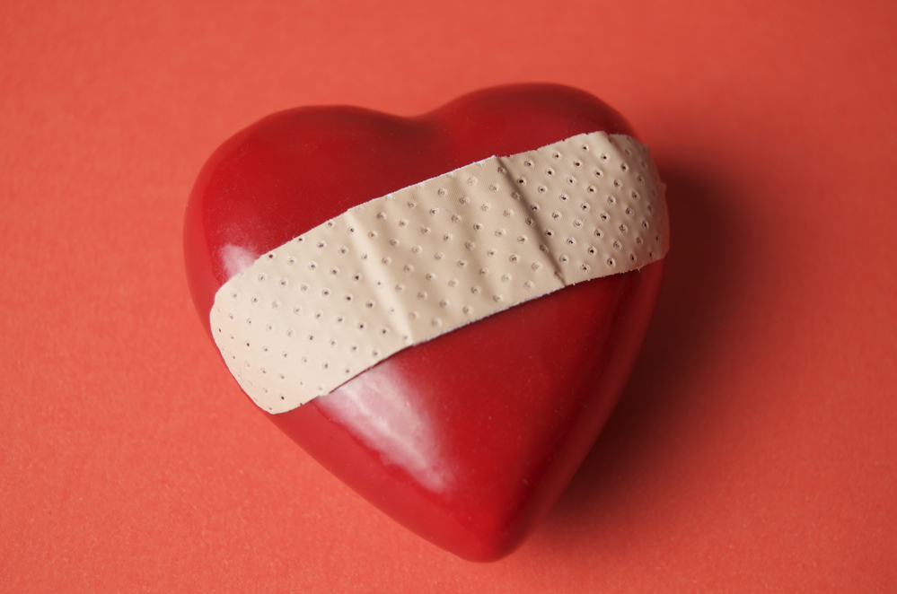
Conflict Resolution
Find the Real Issue. Typically, arguments happen when one partner’s wants are not being met. Try to get to the heart of the matter. If your partner seems needy, maybe they are just feeling insecure and need your encouragement. If you’re angry that your partner isn’t taking out the trash, maybe you’re really upset because you feel like you do all the work around the house. Learn to talk about what the real issue so you can avoid constant fighting.

Slide 12

Conflict Resolution
Agree to Disagree. If you and your partner can’t resolve an issue, sometimes it’s best to drop it. You can’t agree on everything. Focus on what matters. If the issue is too important for you to drop and you can’t agree to disagree, then maybe you’re not really compatible.

Slide 13
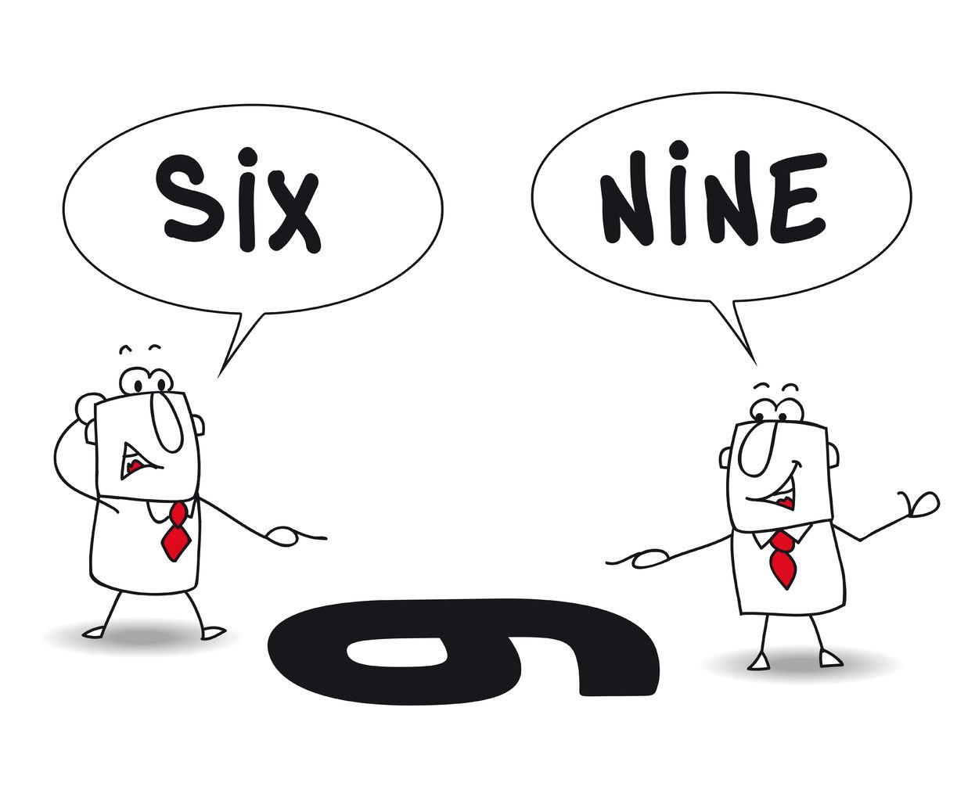
Consider Everything. Is this issue really important? Does it change how the two of you feel about each other? Are you compromising your beliefs or morals? If yes, it's important that you really stress your position. If not, maybe this is a time for compromise. Also, consider your partner’s arguments. Why are they upset? What does the issue look like from their point of view? It is unusual for your partner to get this upset? Does your partner usually compromise? Are you being inconsiderate?
Remember, you are entitled to and are deserving of a healthy relationship without conflict.

Slide 14
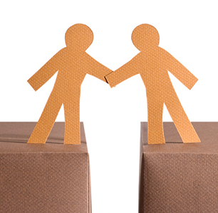
Conflict Resolution
Compromise When Possible. Easy to say but hard to do, compromising is a major part of conflict resolution and any successful relationship. So your partner wants Chinese food and you want Indian? Compromise and get Chinese tonight, but Indian next time you eat out. Find a middle ground that can allow both of you to feel satisfied with the outcome.

Slide 15
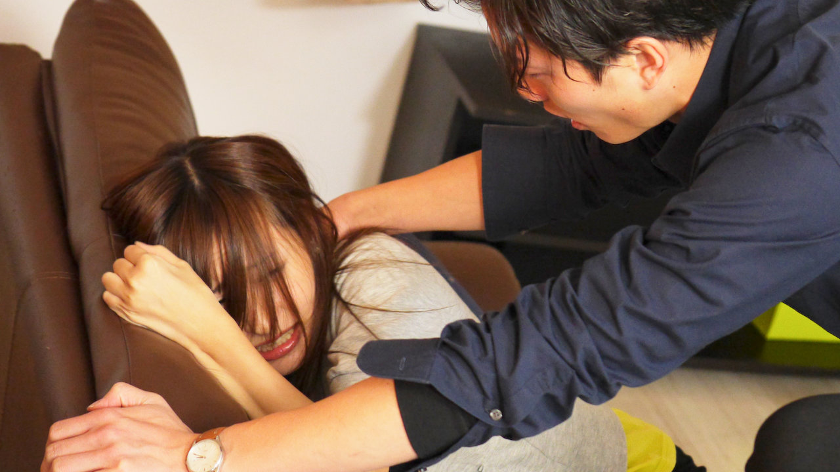
Date Rape
When someone you know socially (but not family) forces you to have sex when you don’t want to. It could be someone you meet at a party, or someone you love and trust, like your boyfriend or girlfriend.

Slide 16

Date Rape
Not just sexual intercourse − it can be oral sex
or some other kind of sex. You may even agree
to have sex with someone, then decide you
want to stop, but they force you to keep going.
Sexual Coercion is the act of using pressure,
force or alcohol and/or drugs, to have sexual contact with someone against his or her will - persistent attempts to have sexual contact with someone who has already refused (post refusal).

Slide 17
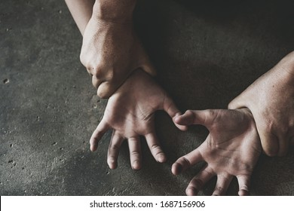
Date Rape
Often hidden because many men and women who have been raped don’t recognize their experience as a crime − they think that because they knew their attacker it wasn’t actually rape.
Just because a victim doesn’t say, “No” does not mean they are willing. A victim may not fight back or scream, but that doesn’t mean sexual intercourse was not forced.

Slide 18
Reporting Dating Violence/Date Rape
For further information on reporting an incident contact:
Public Safety (760)341-2111
or
2111 (from a campus phone)
**In case of an emergency, dial 9-1-1.

