Slide 1
Stalking
College of the Desert Public Safety Department & Emergency Preparedness
2021

Slide 2
Stalking is the act of a person who, on more than one occasion, follows, pursues or harasses another person, and by actively engaging in a pattern of conduct, causing the victim to believe the stalker will cause physical harm or mental distress to them.
Pattern of Conduct means two or more actions or incidents closely related in time, whether or there has been a prior conviction based on any of those actions or incidents.
Mental Distress means any mental illness or condition that involves incapacity for a short time or a condition that would require psychiatric treatment.
What is stalking?
Notes:
The definition is from the CLERY Center 2021 literature.

Slide 3
Statistics of Stalking
on College Campuses
13% of college women were stalked during a 6-9 month period.
80% of campus stalking victims knew their stalkers.

Slide 4
Who do stalkers target?
Anyone can be targeted by a stalker.
Stalkers are often former spouses or partners. A stalker may target a public figure or celebrity, a child, a casual acquaintance, or a complete stranger. A stalker may intrude by following a victim to and from home, work, school/college/university or social activities. A stalker sometimes intrudes by making harassing telephone calls or sending threatening mail.

Slide 5
Stalking Behaviors
  Assaulting the victim.
  Violating protective orders.
  Sexually assaulting the victim.
  Vandalizing the victim’s property.
  Burglarizing the victim’s home or otherwise stealing from the victim.
  Threatening the victim.
  Sending the victim cards or gifts.
  Leaving telephone or email messages for the victim.
  Disclosing to the victim personal information the offender has discovered about them.
  Disseminating personal information about the victim to others.
  Following the victim.
  Visiting the victim at work or school.
  Waiting outside the victim’s house.
  14. Sending the victim photographs taken of him or her without consent.

Slide 6
What the Victim Should Do:
Notify the Police
Notify Campus Security
Maintain a Record
The victim should maintain a detailed record of each encounter with the stalker. Included in this record of incidents should be dates, times, locations, complete description of the offender, words spoken, actions taken during the incident, actions taken afterward and names of witnesses.
This is the first thing victims of stalking incidents should do. They should notify the police department where they life and where they work.
Students should notify campus security of any stalking incidents on and off campus if they are concerned for their safety while on campus.

Slide 7
What the Victim Should Do:
Seek a Protection Order
Temporary, emergency or civil protection orders are court orders intended to keep the stalker away from the victim by making it illegal for the stalker to have contact with the victim. In most jurisdictions, a person who violates this order can be found in contempt of court and jailed or fined.
Safety Tips
Advise law enforcement and/or campus security if you feel threatened.
Program 9-1-1 on your cell phone such as the “1”key.
Be sure your vehicle doors are locked while you are in the vehicle, and check in and around the vehicle before entering it.
Request an escort to and from your vehicle.
Avoid walking alone, especially at night or in isolated areas.

Slide 8
To Report A Crime
To report any crime that occurs on a College of the Desert Campus or location:
Contact 760-341-2111 anytime 24/7/365
Contact local law enforcement
  COD Public Safety Department officers and staff are available to
  assist you in making a report.
Keep any and all documentation/evidence
Assistance with on campus escorts is available

Slide 9

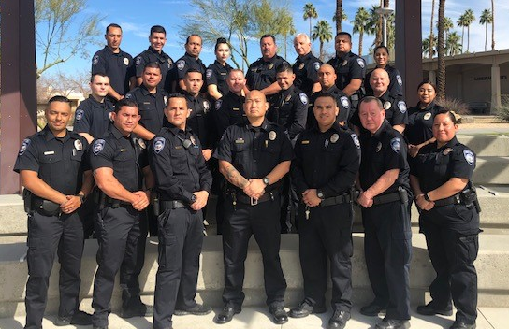
College of the Desert
Public Safety Department & Emergency Preparedness

